Slide 1
Progress on NL-Soar, and Introducing XNL-Soar
Deryle Lonsdale, Jamison Cooper-Leavitt,
and Warren Casbeer
(and the rest of the BYU NL-Soar Research Group)
BYU Linguistics
lonz@byu.edu

Slide 2

What appears to be happening with NL-Soar support
NL-Soar?

Slide 3
What appears to be happening with NL-Soar support
NL-Soar?
> /dev/null

Slide 4
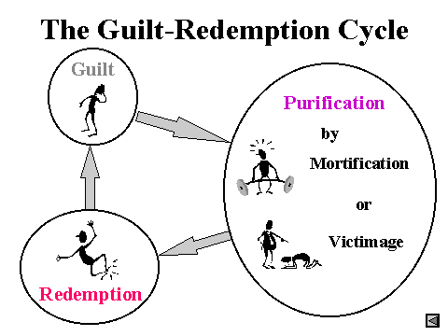
What’s actually happening with
NL-Soar support

Slide 5
What’s actually happening with
NL-Soar support

Slide 6
What’s actually happening with
NL-Soar support

Slide 7
What’s actually happening with
NL-Soar support

Slide 8
NL-Soar developments (1)
Discourse/robotic dialogue
  Sphinx-4 speech input (working on lattice-based interface)
  Festival text-to-speech output
  Two agents holding a (short) conversation
  Video produced showing round-trip speech-based human/robot interaction
  NSF proposal submitted

Slide 9
NL-Soar developments (2)
NL generation
  Decoupled from comprehension
  Can be driven from arbitrary LCS
    Front-end GUI for creating LCS’s
Port to Soar 8.5.2
  Some NLG chunking issues remain
Modeling of cognition in simultaneous interpretation (English-French)

Slide 10
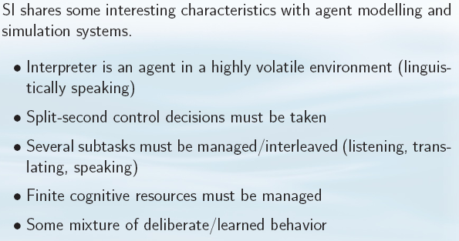
SI from a cognitive modeling perspective

Slide 11
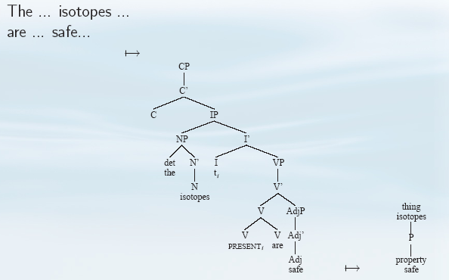
Parsing and the models

Slide 12
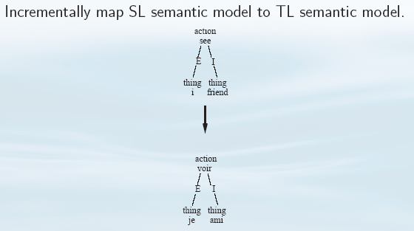
Mapping operators

Slide 13
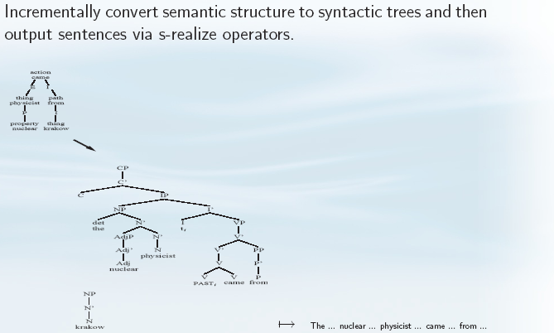
NL-Soar generation operators

Slide 14
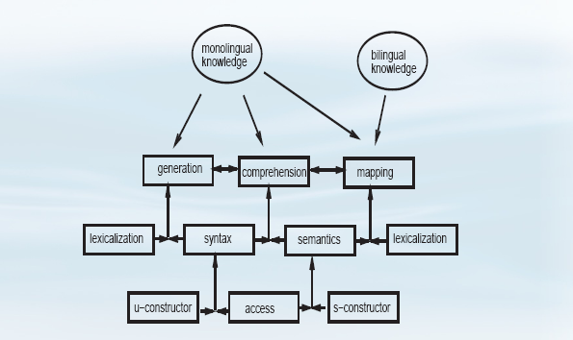
Combining the capabilities

Slide 15
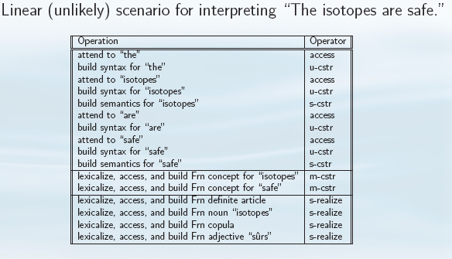
Pipelining the processes

Slide 16
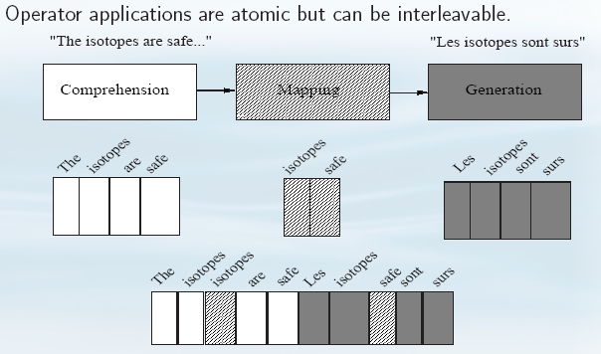
Interleaving operator implemen-tations

Slide 17
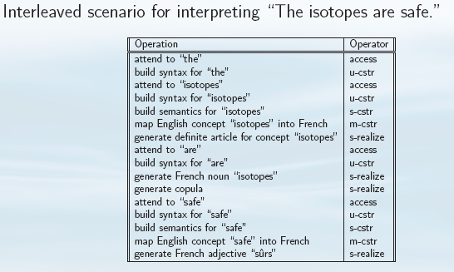
Interleaving the processes

Slide 18
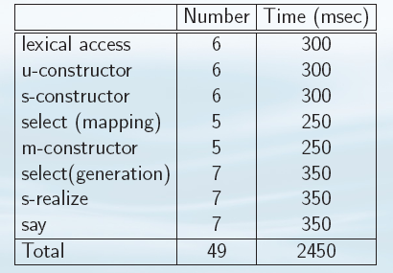
Predicted times by operator type

Slide 19
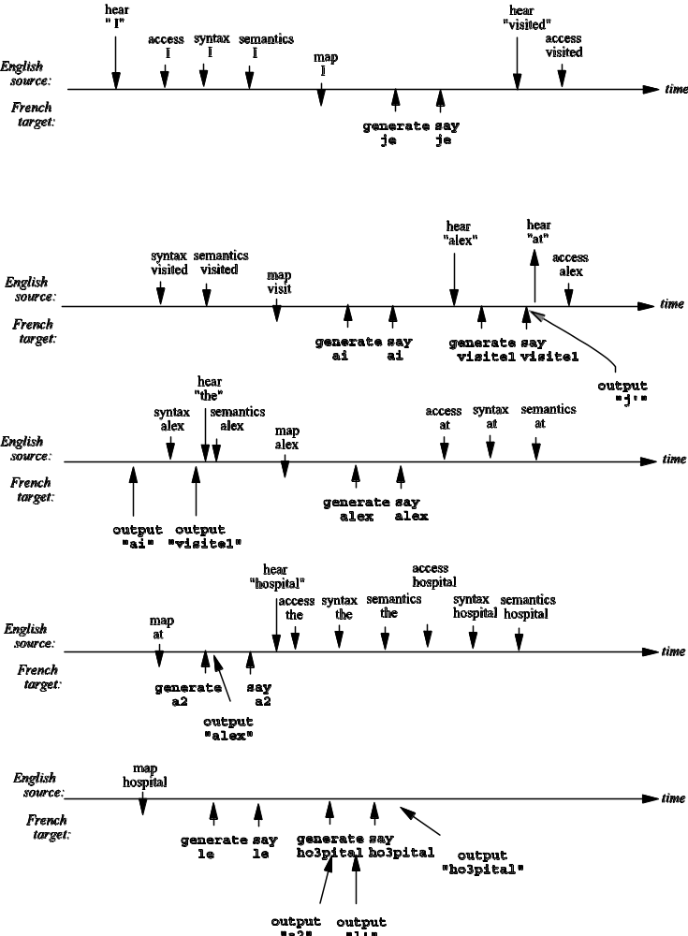
Event timeline (one possibility)

Slide 20
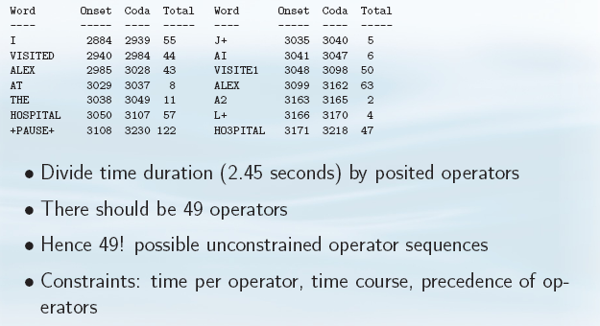
Sample alignment analysis

Slide 21
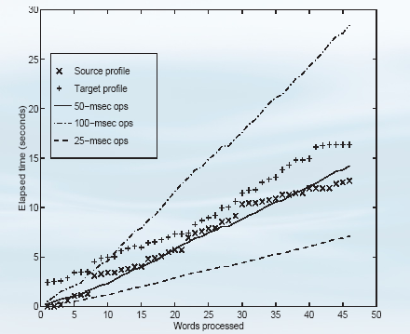
Observed profile and timing assumptions

Slide 22
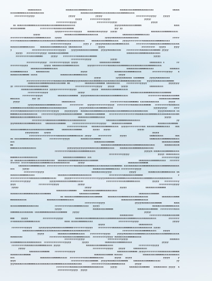

First 1/3 of an interleaved scenario timeline

Slide 23
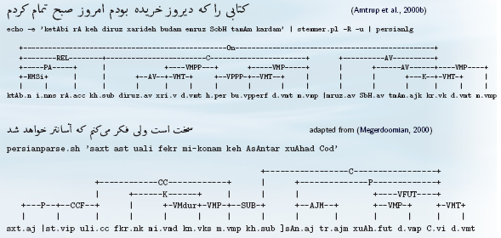
LG-Soar developments
Predicate extraction in biomedical texts domain (www.clinicaltrials.gov)
Scaling up of Persian syntactic parser

Slide 24
Unveiling XNL-Soar: Minimalism and Incremental Parsing

Slide 25
What are we trying to do?
As with NL-Soar, study how humans process language
  Lexical access
  Syntax/semantics
Apply the Soar architecture
  Operator-based cognitive modeling system
  Symbolic, rule-based, goal-directed agent
  Learning
Implement syntax in the Minimalist Program

Slide 26
Why XNLS? (1)
GB has been (largely) superseded by MP
It’s a debatable development (e.g. recent LinguistList discussion/flamefest)
No large-scale MP parser implemented yet
No MP generator implemented yet
Flavor seems right (even operators!)
I just re-read Rick's thesis, and I wondered if you've thought at all about applying "newer" grammars (e.g., Chomsky's "minimalist programme") in NL-Soar? (Chris Waterson, June 17, 2002)

Slide 27
Why XNLS? (2)
Incrementality of MP not explored
Unknown whether MP viable for human sentence processing (but claimed to be)
Experience with another formalism
  Syntax so far: GB, Link Grammar
  Semantics so far: Annotated models, LCS, DRT
Pedagogical aims

Slide 28
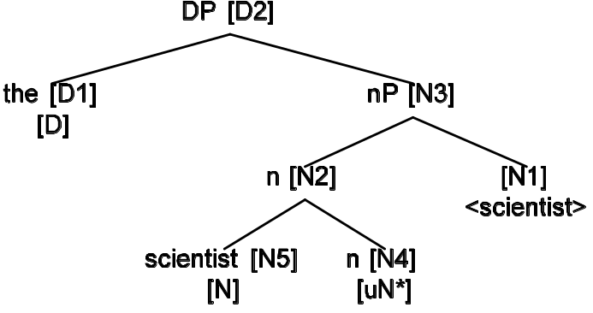
After hearing “The scientist...”

Slide 29
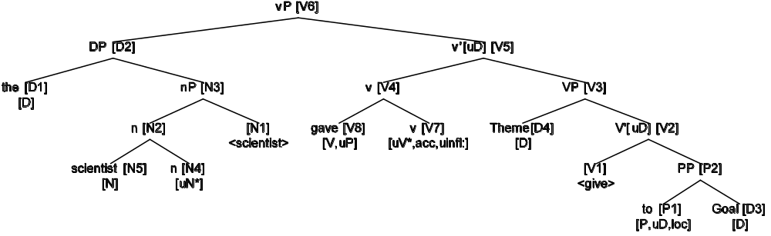
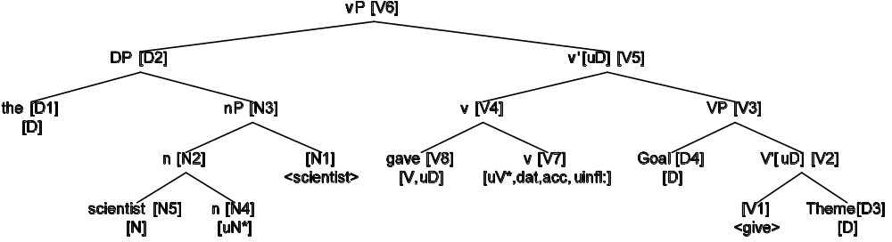
After hearing “The scientist gave...”

Slide 30
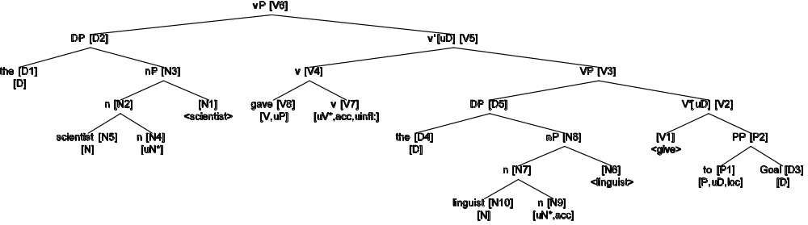
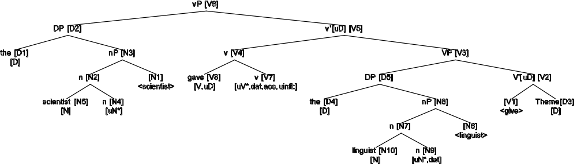
After hearing “The scientist gave the linguist...”

Slide 31
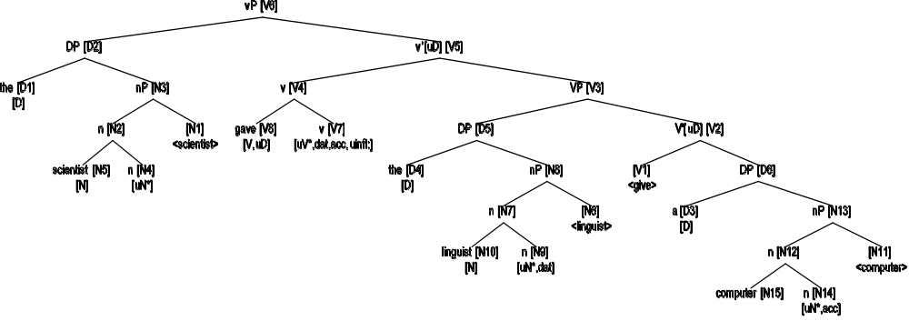
After hearing “The scientist gave the linguist a computer.”

Slide 32
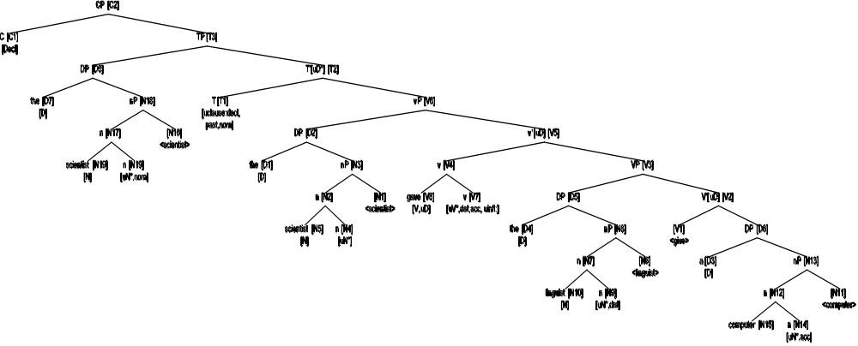
Projecting the structure

Slide 33
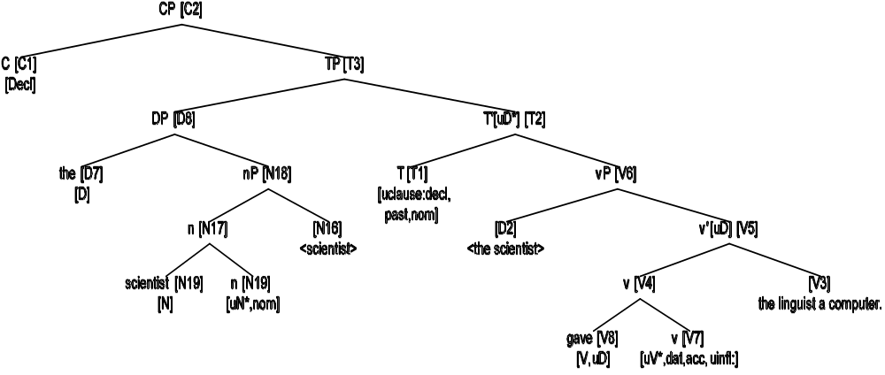
Completed tree for “The scientist gave the linguist a computer.”

Slide 34
Operator types (still to be done)
(Attention)
Lexical access (from NL-Soar, including WordNet)
Merge: link 2 pieces of syntactic structure
  Constraints: subcategorization, (hierarchy of projections), (theta roles: PropBank?)
Move: moves a constituent (e.g. questions)
  Constraints: locality, features
(Snip)

Slide 35
Operator types
Inherit from NL-Soar:
  Semantics: build pieces of conceptual representation
  Discourse: select and instantiate discourse plans for comprehension and generation
  Generation: generate text from semantic representation

Slide 36
Other system components
Assigners/receivers set?
Parameterized decay-prone I/O buffer
New grapher for MP parse trees

Slide 37
Current status
Current XNLS system: about 40 rules
(c.f. NL-Soar system: 3500 rules)
Intransitive sentences
  Basic sentences work (e.g. ‘zebras sneezed’)
WordNet gives us uninflected forms; this is a problem for generation

Slide 38
Expected payoffs
Crosslinguistic development
  Easier to parameterize due to features
Wider coverage of complex constructions
  Ditransitives, resultatives, causatives, unaccusatives, etc.
More workable platform for implementing partial analyses from the literature

Slide 39
Conclusion
Coals
  Performance?
  MP not fully explored
  More highly lexicalized, so more lexical resources required
  XNLS entails the Guilt-Redemption cycle
Nuggets
  Better coverage (Engl. & crosslinguistically)
  New start in Soar8
  State-of-the-art syntax
  Puts us in the thick of the battle
  Relevance to current linguistic pedagogy

